Slide 1
Welcome!
Hari Polnati

Slide 2
Agenda
Quick Overview on JavaScript and Typescript
JavaScript Eventloop – How JS will work internally
Sync vs Async Events in JS
Deep Dive into JS Engine
What is Node.js
JS vs NodeJS
When to use and not to use node.js.
Node Module System
Node Package Manager
What is Express and Build REST API using Express
Some Advance Concepts in Express (Middleware, custom middleware,Environments and Configuration)
CRUD using MonogoDB/CosmosDB/MySQL
Error Handling
Converting everything in Typescript
Basic of Unit testing and TDD

Slide 3

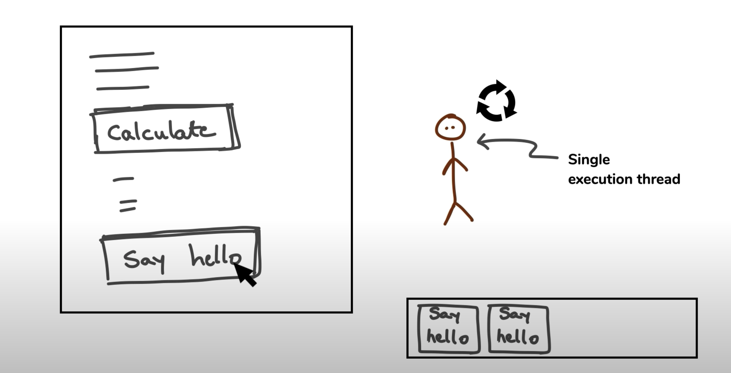
JavaScript Event Loop
JavaScript Events
Synchronous Events (blocking)
Async (non-blocking)
Threading
Single Threaded

Slide 4


Async- Real time example

Slide 5
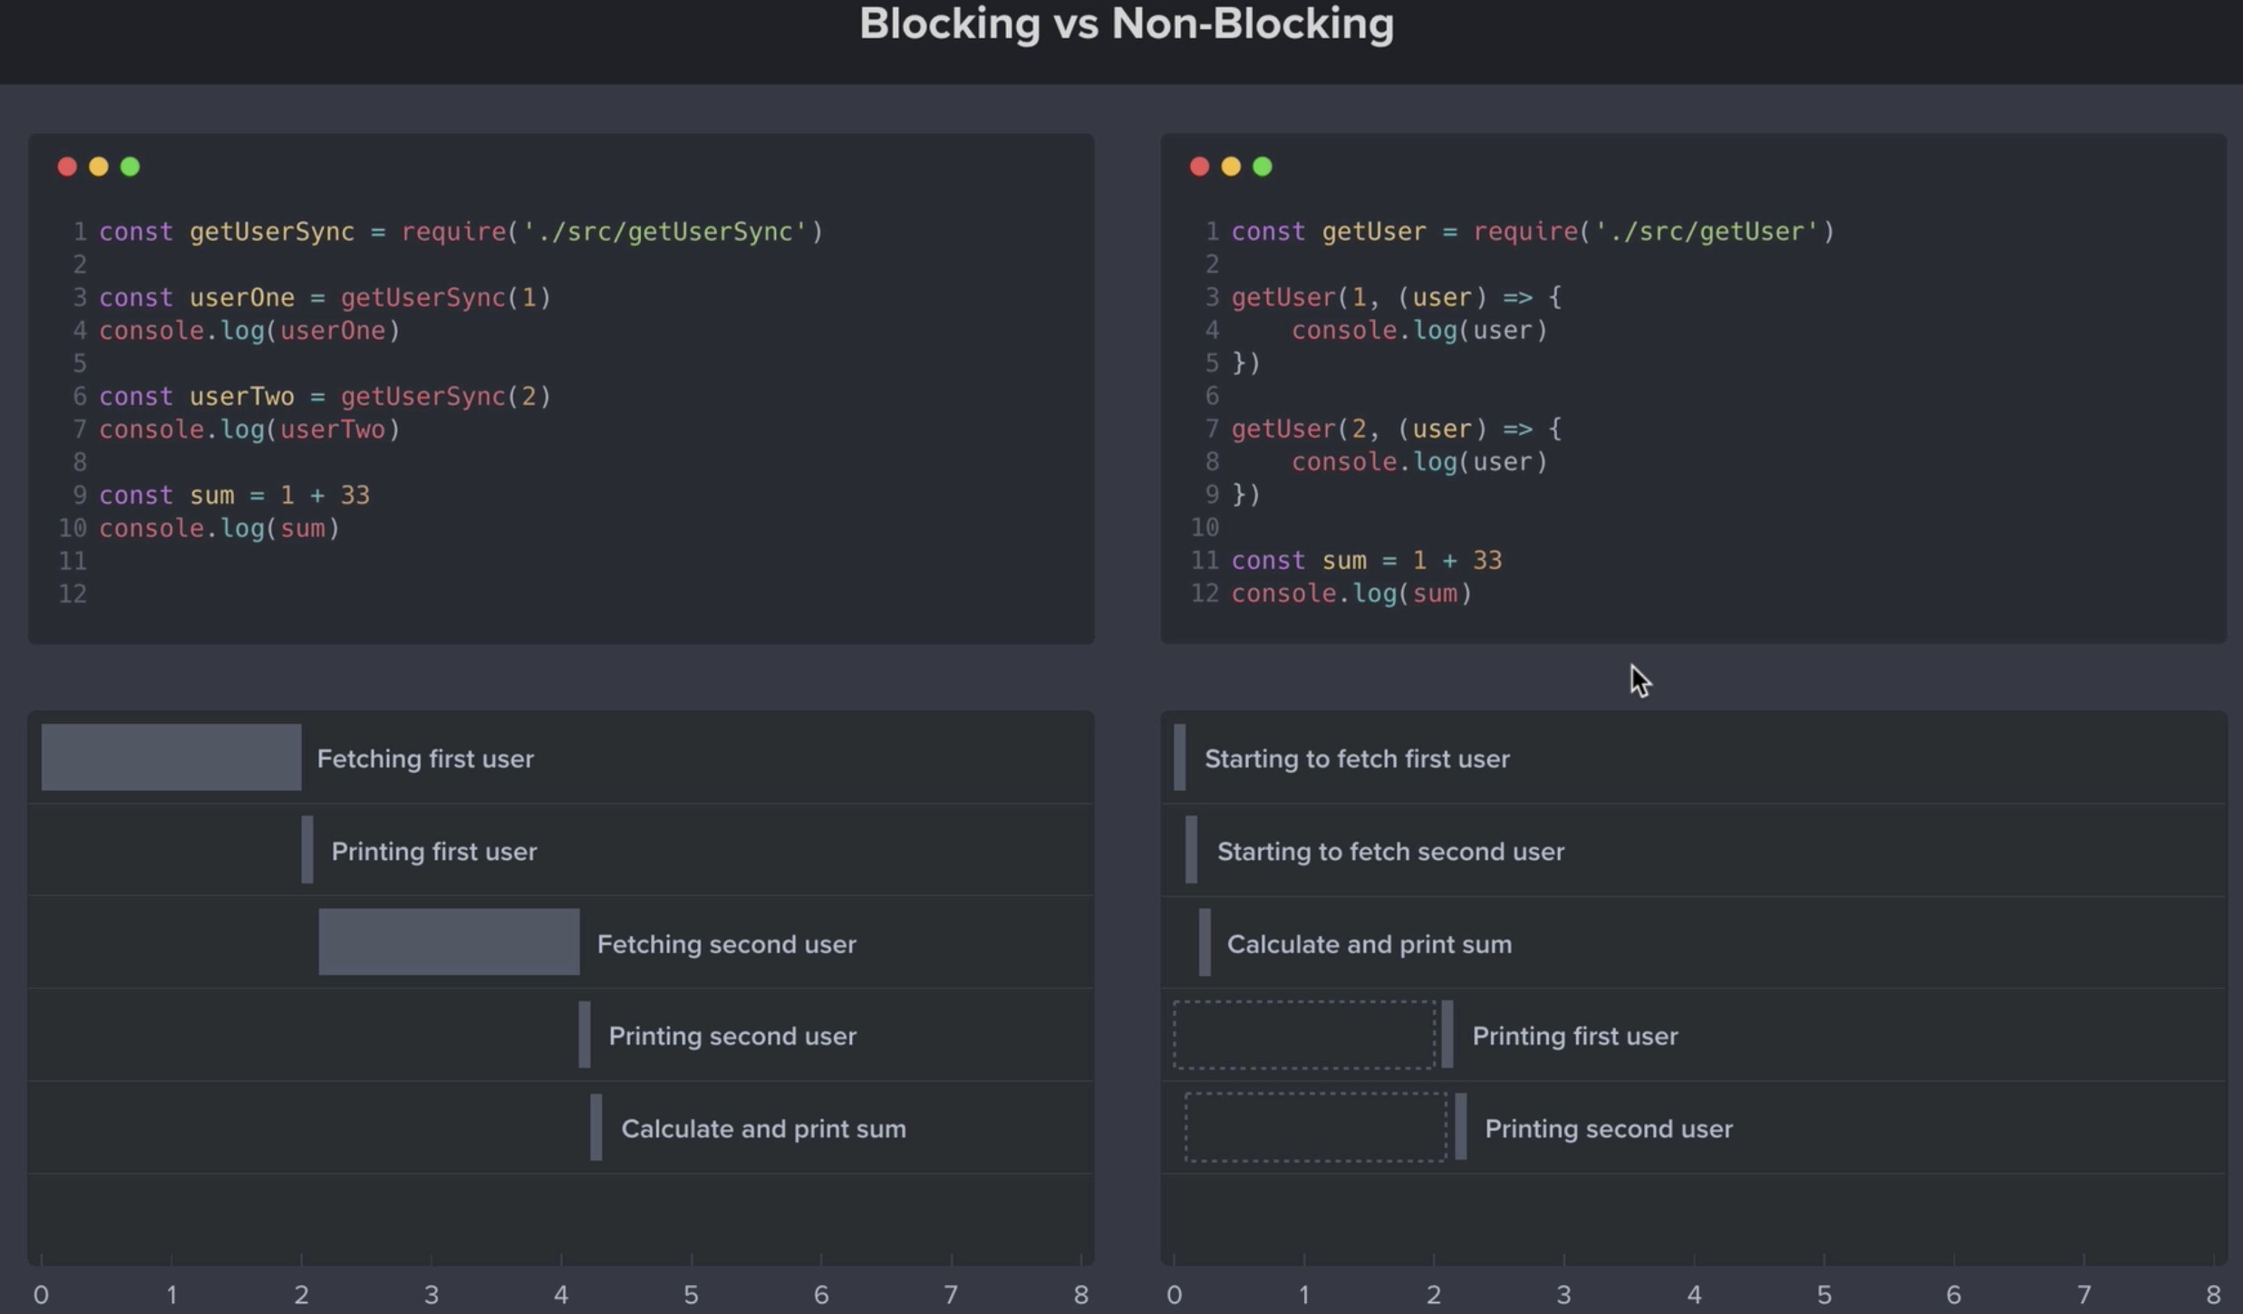

Slide 6
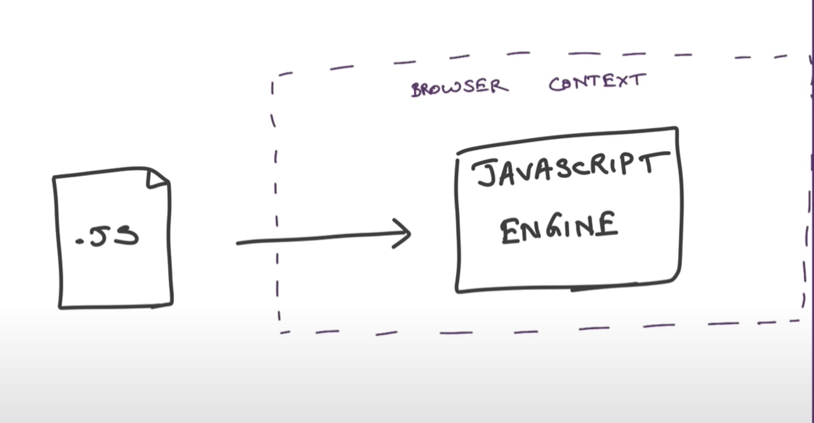
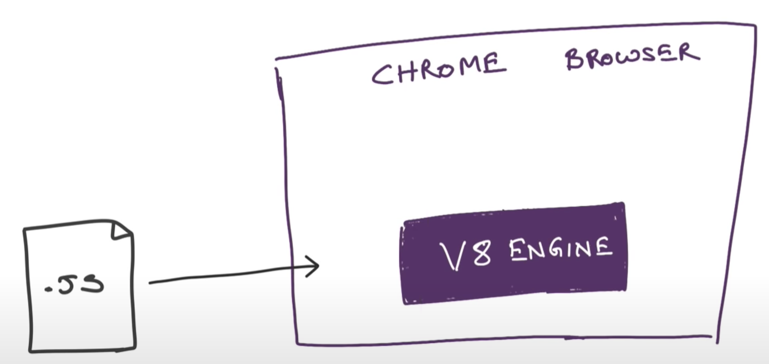
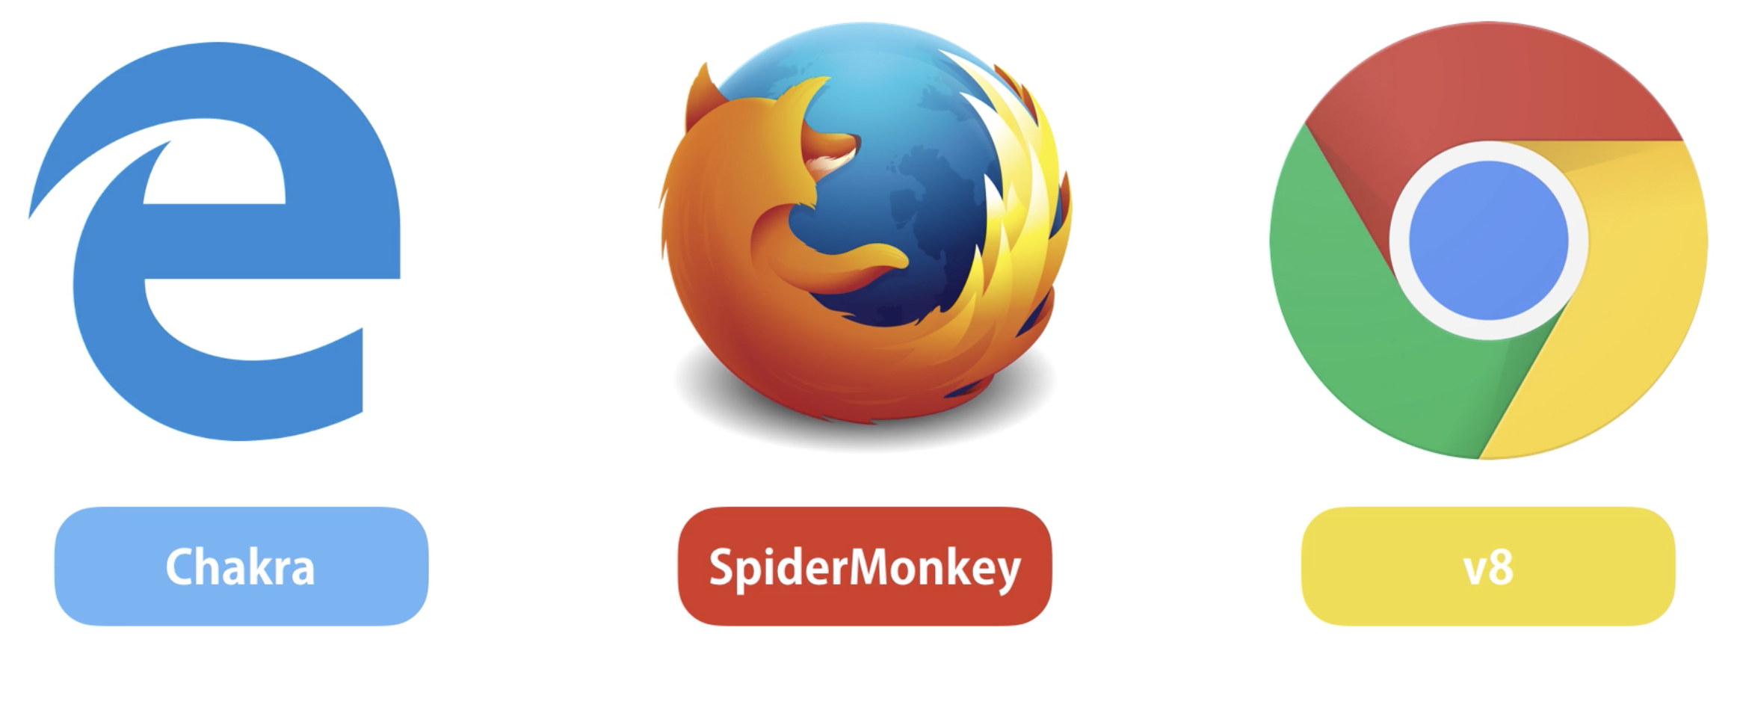
Understand JS Engine
Let’s first try to understand JS in browser
Different Browsers has different implementation
Firefox has SpiderMonkey
Safari has JavaScriptCore (also called Nitro)
Edge was originally based on Chakra but has more recently been rebuilt using Chromium and the V8 engine.

Slide 7
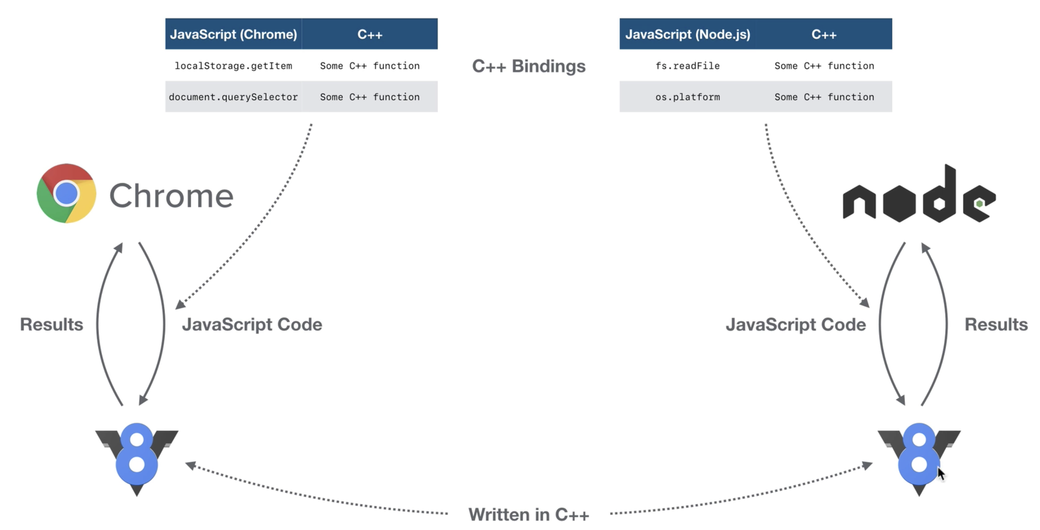
V8 JavaScript Engine

Slide 8
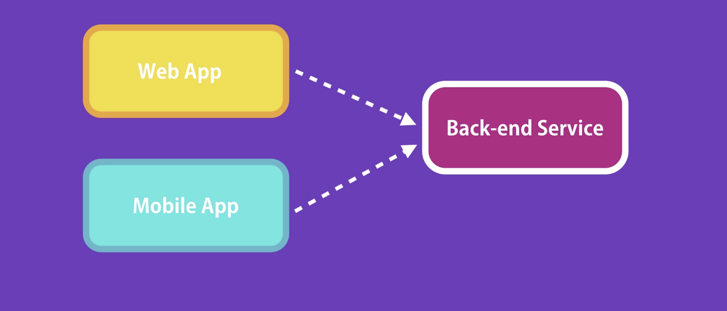
Understand NodeJS
NodeJS: Node.js is JavaScript runtime built on Chrome’s V8 JavaScript Engine
Doc : https://nodejs.dev/learn/introduction-to-nodejs
Node is not a programming language
Async Non-blocking I/O Model. Node apps are default async
Access to System resources, Memory,file System ,I/O, network, API, and more…
HTML + JS/React
NodeJS App
iOS/Android

Slide 9
Where/When to use NodeJS /NodeJS Shines
Non-Blocking
Event-Driven
Data-intenstive – (CRUD)
I/O intensive

Slide 10
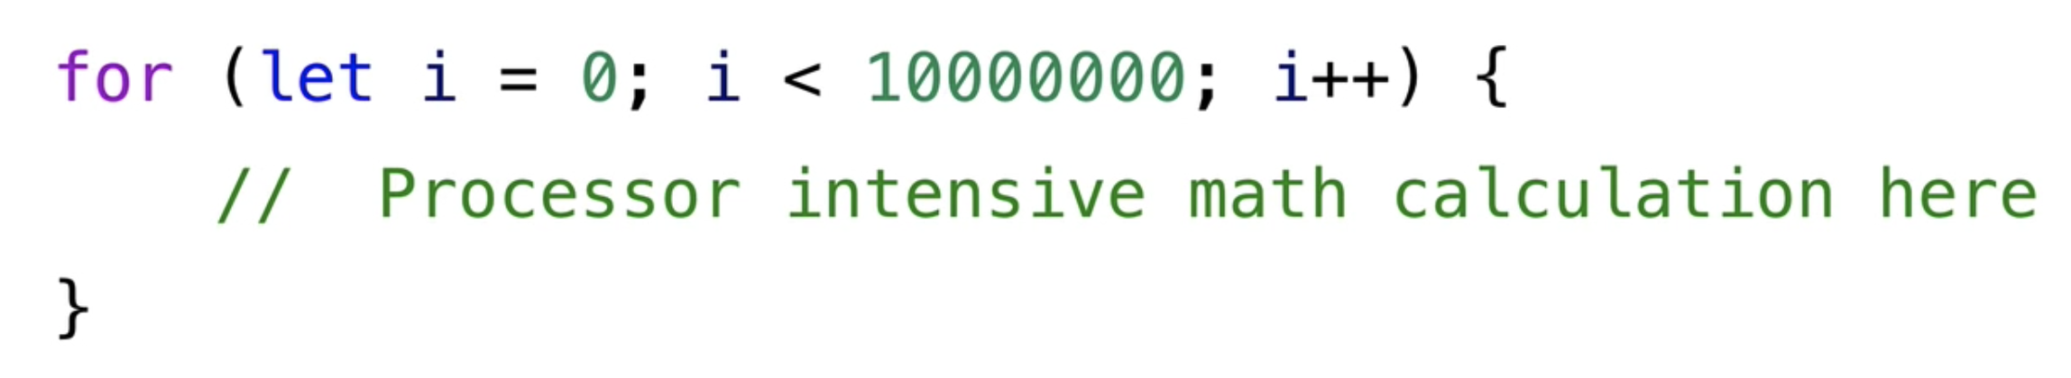
Where Nodejs doesn’t fit
Processor intensive
Data calculations
Blocking operations
Example: CPU-intensive applications, such as a video encoding service. Because while executing these operations, other clients have to wait for the single thread to finish its job and be ready to serve them

Slide 11
Dev Environment setup
Visual Studio code
Node.js, Typescript (tsc)
Postman
npm install –g typescript

Slide 12
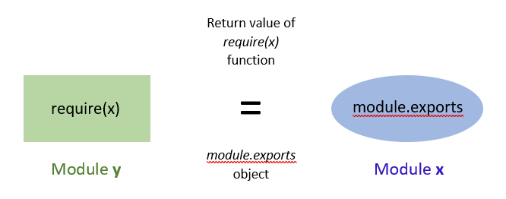
What and Why modules?
In Node. js, Modules are executed within their own scope, not in the global scope; this means that variables, functions, classes, etc. declared in a module are not visible outside the module unless they are explicitly exported
Modules are the blocks of encapsulated code that communicates with an external application on the basis of their related functionality.
Modules can be a single file or a collection of multiples files/folders
Each module in Node.js has its own context, so it cannot interfere with other modules or pollute global scope.
How to export a module

Slide 13
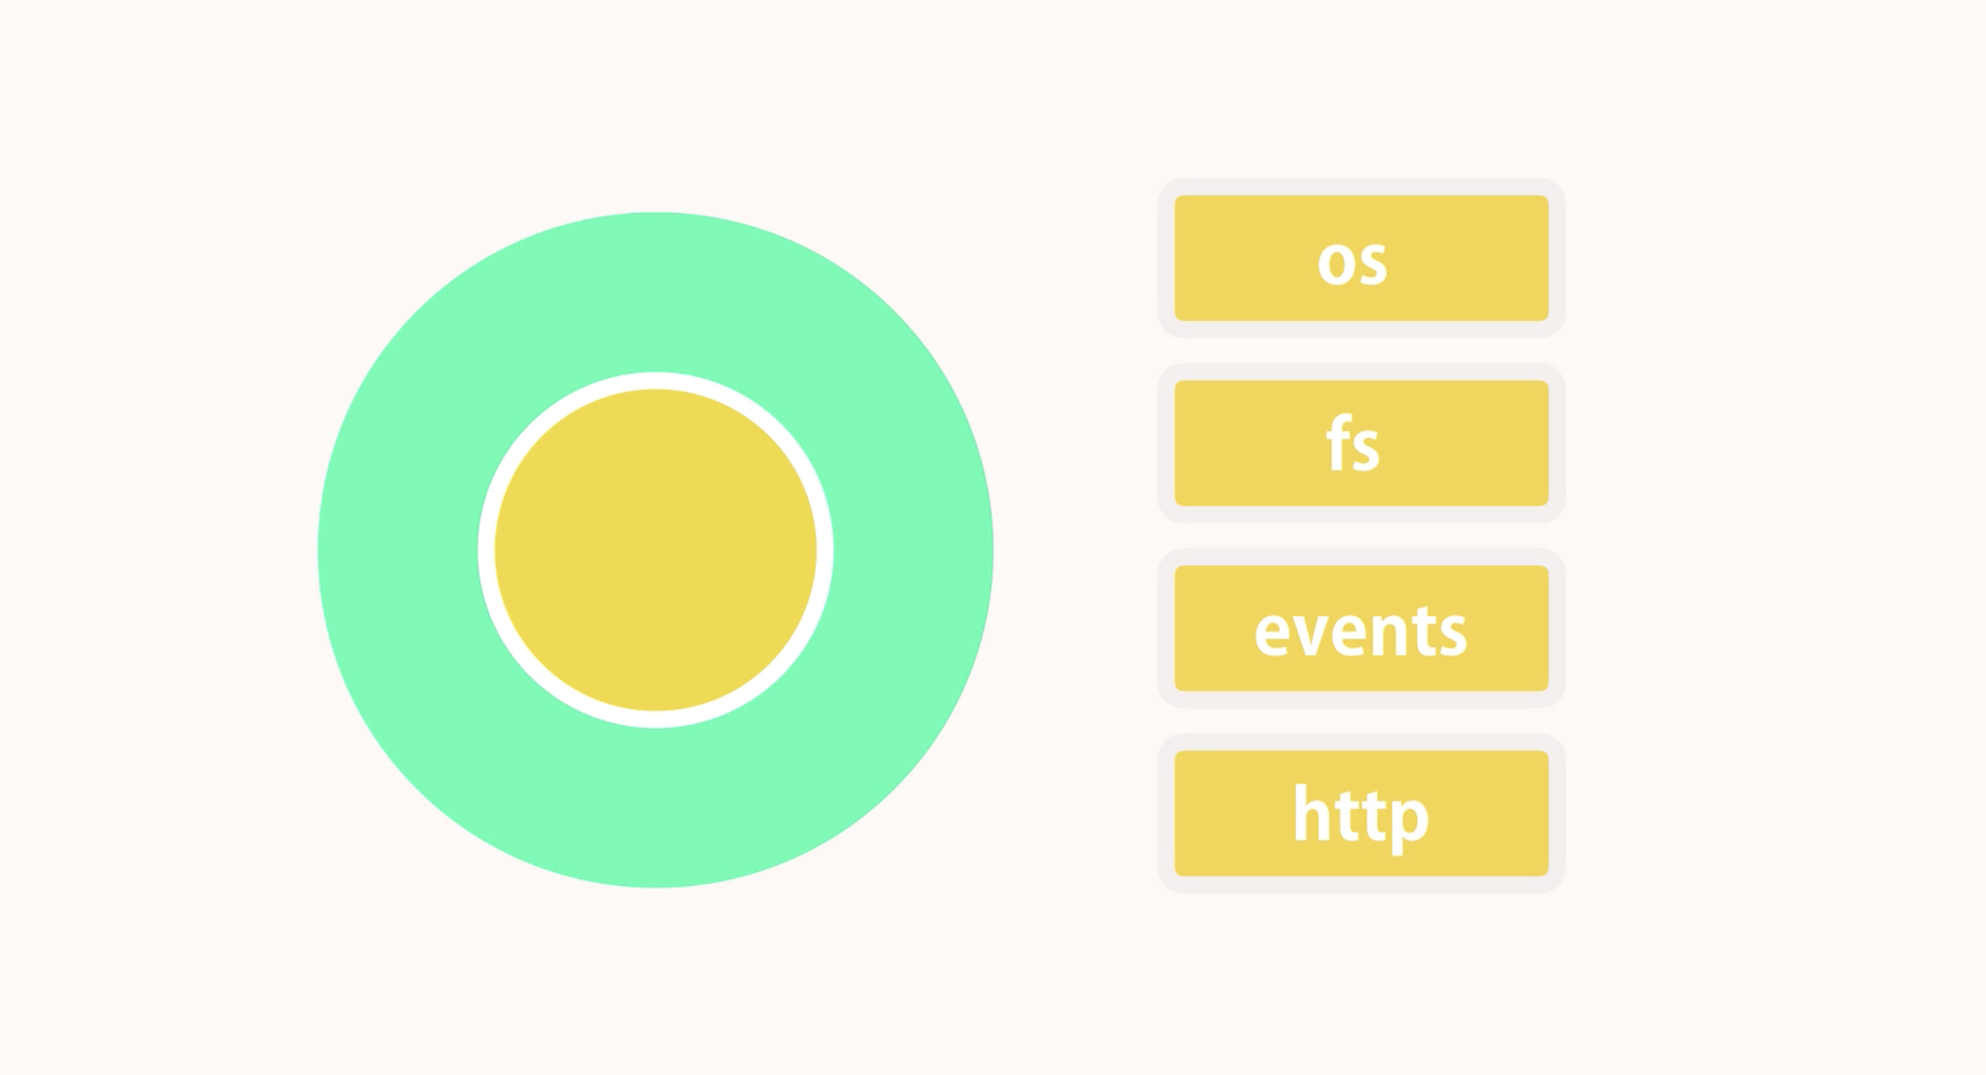
Node Modules

Slide 14
NPM
NPM: Every Node application has a package.json file that includes metadata about the application. This includes the name of the application, its version, dependencies, etc.
We use NPM to download and install 3rd-party packages from JfrogArtifictory/NPM registry.
All the installed packages and their dependencies are stored under node_modules folders. This folder should be excluded from the source control.
Node packages follow semantic versioning: major.minor.patch.
Useful NPM commands are:
Install a package -> npm i <package>
Install a specific version of a package -> npm i @<package>
Install a package as a development dependency -> npm i —save-dev <package> (or) npm i –D <package>
Uninstall a package npm un <package>
List installed packages npm list —depth=0
List of globally installed npm list —depth=0 -g
View outdated packages npm outdated
Update packages npm update
To install/uninstall packages globally, use -g flag

Slide 15
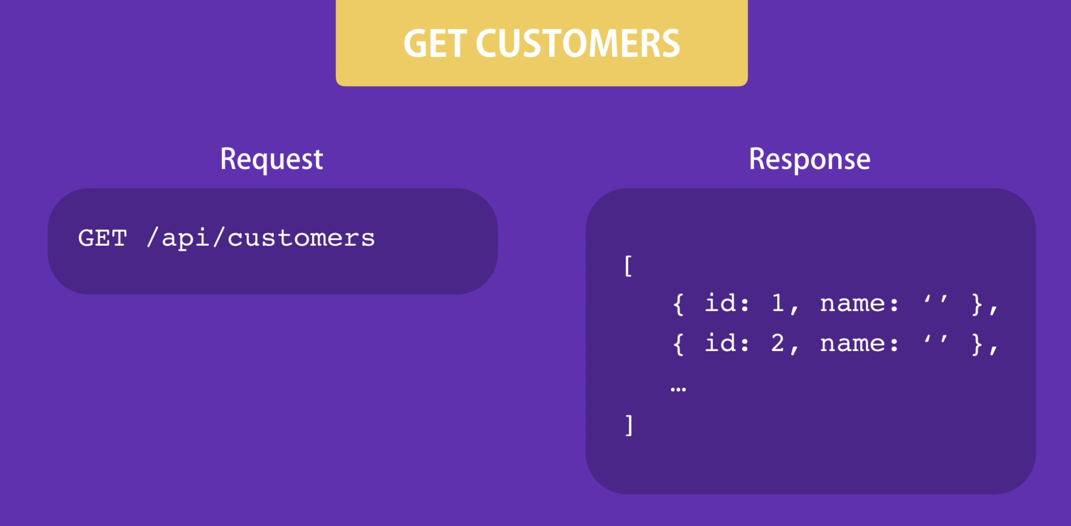
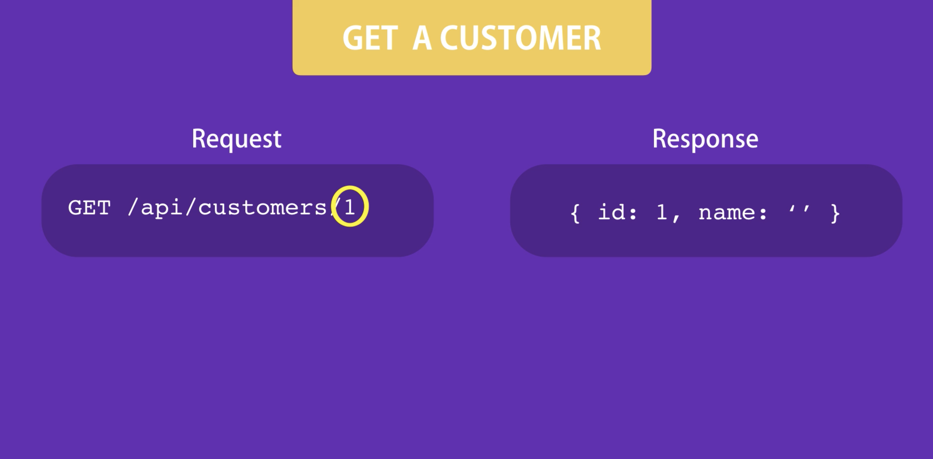
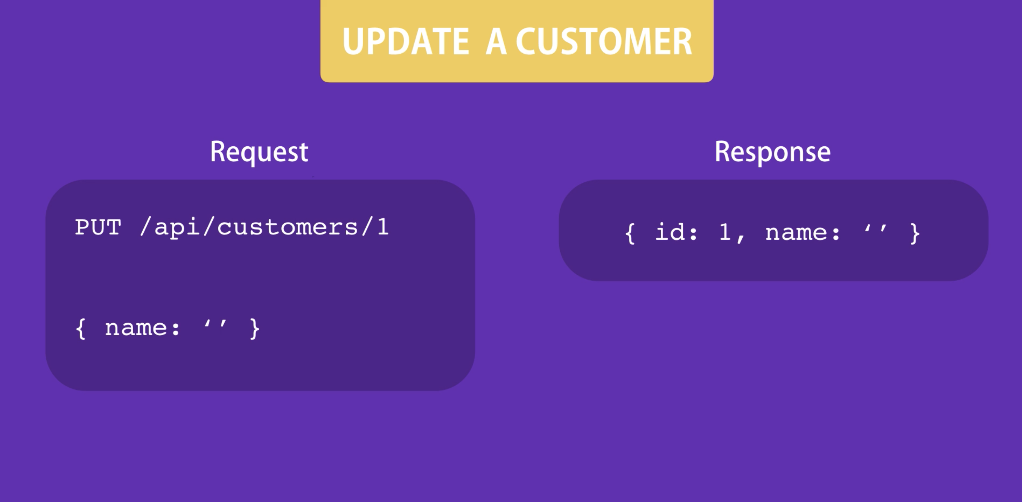
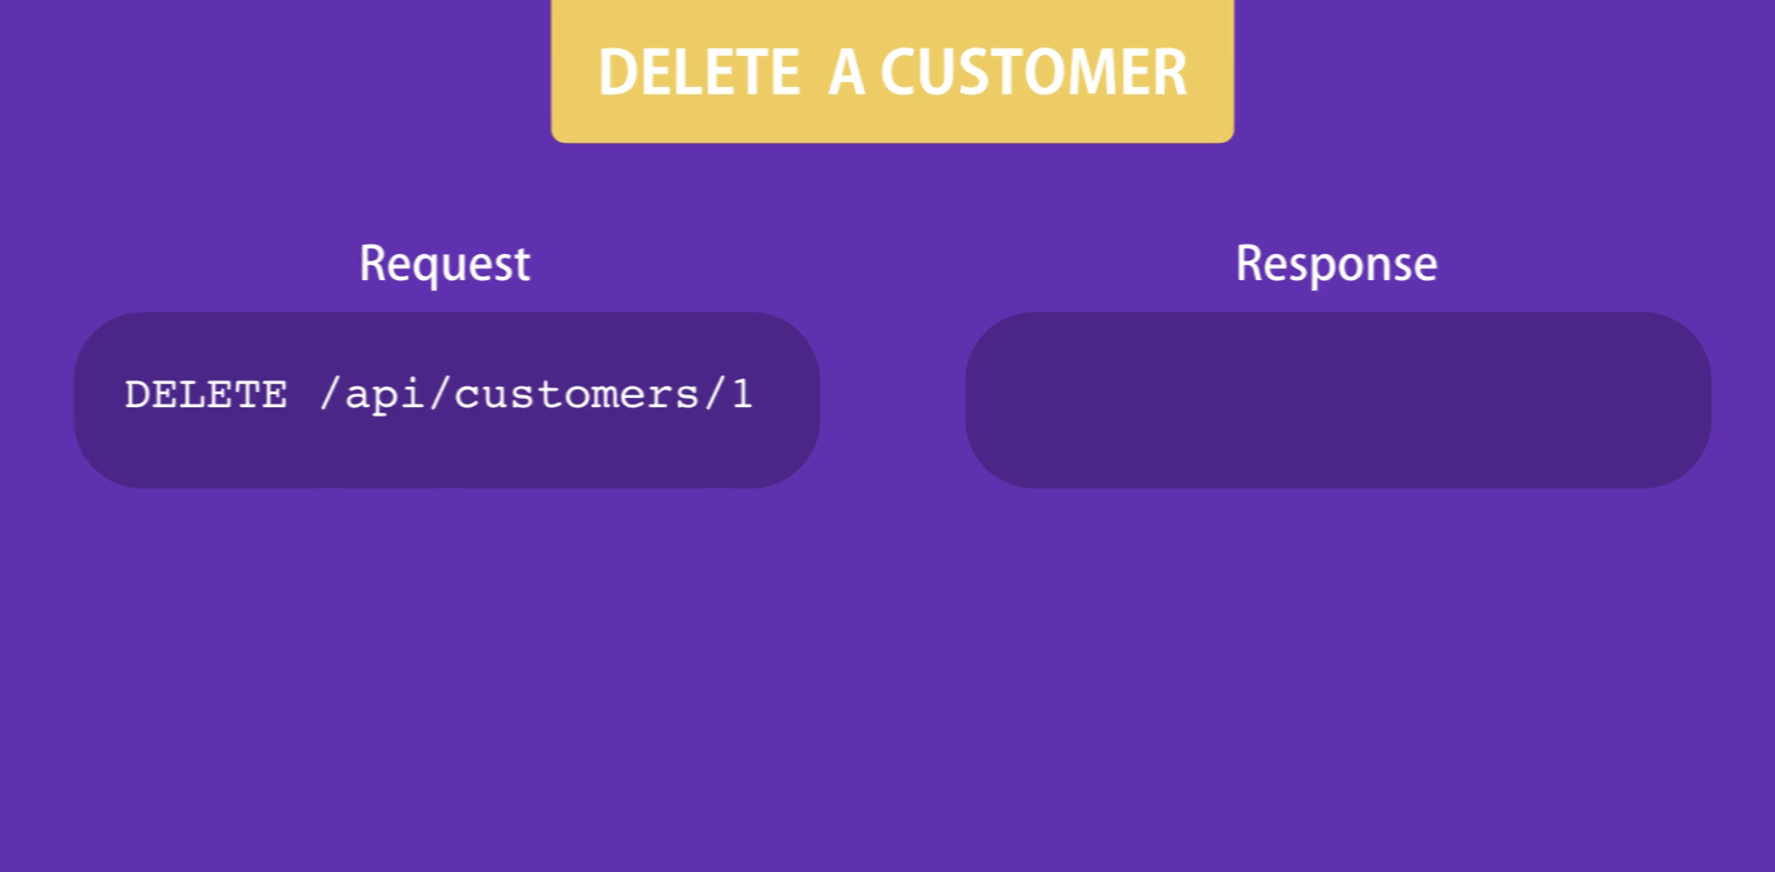
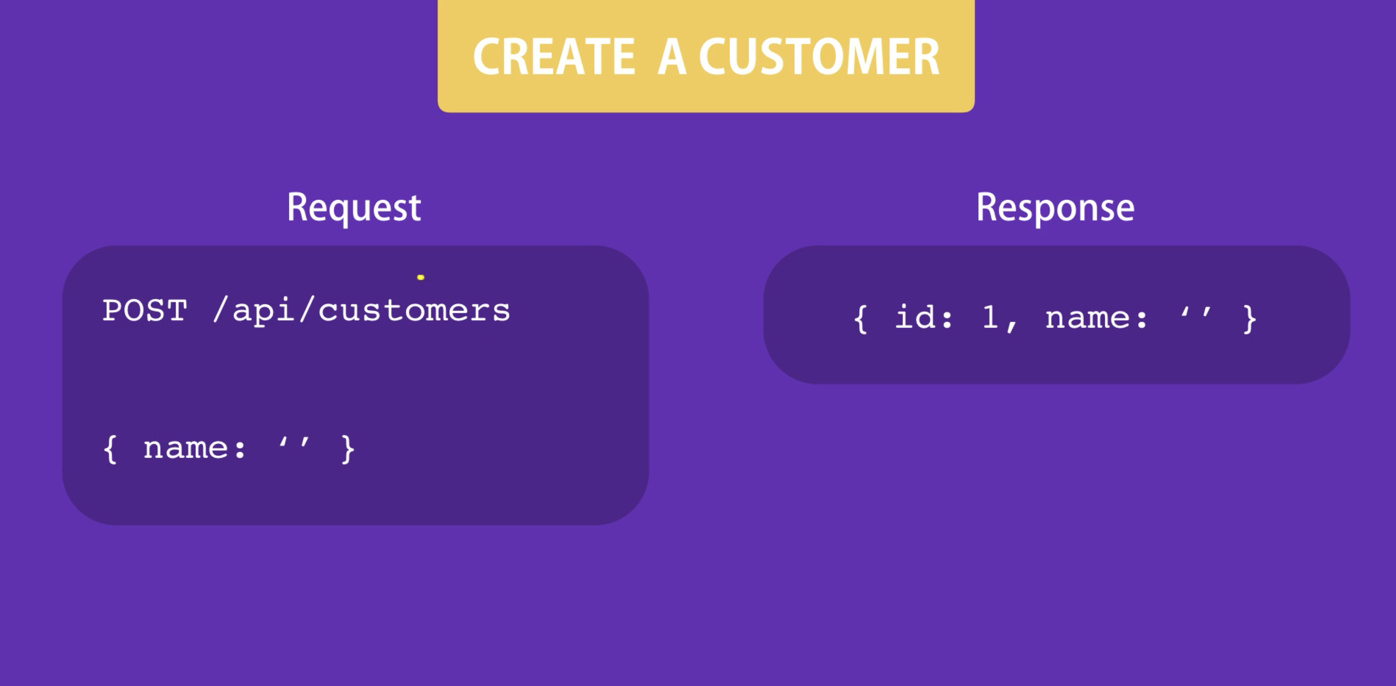
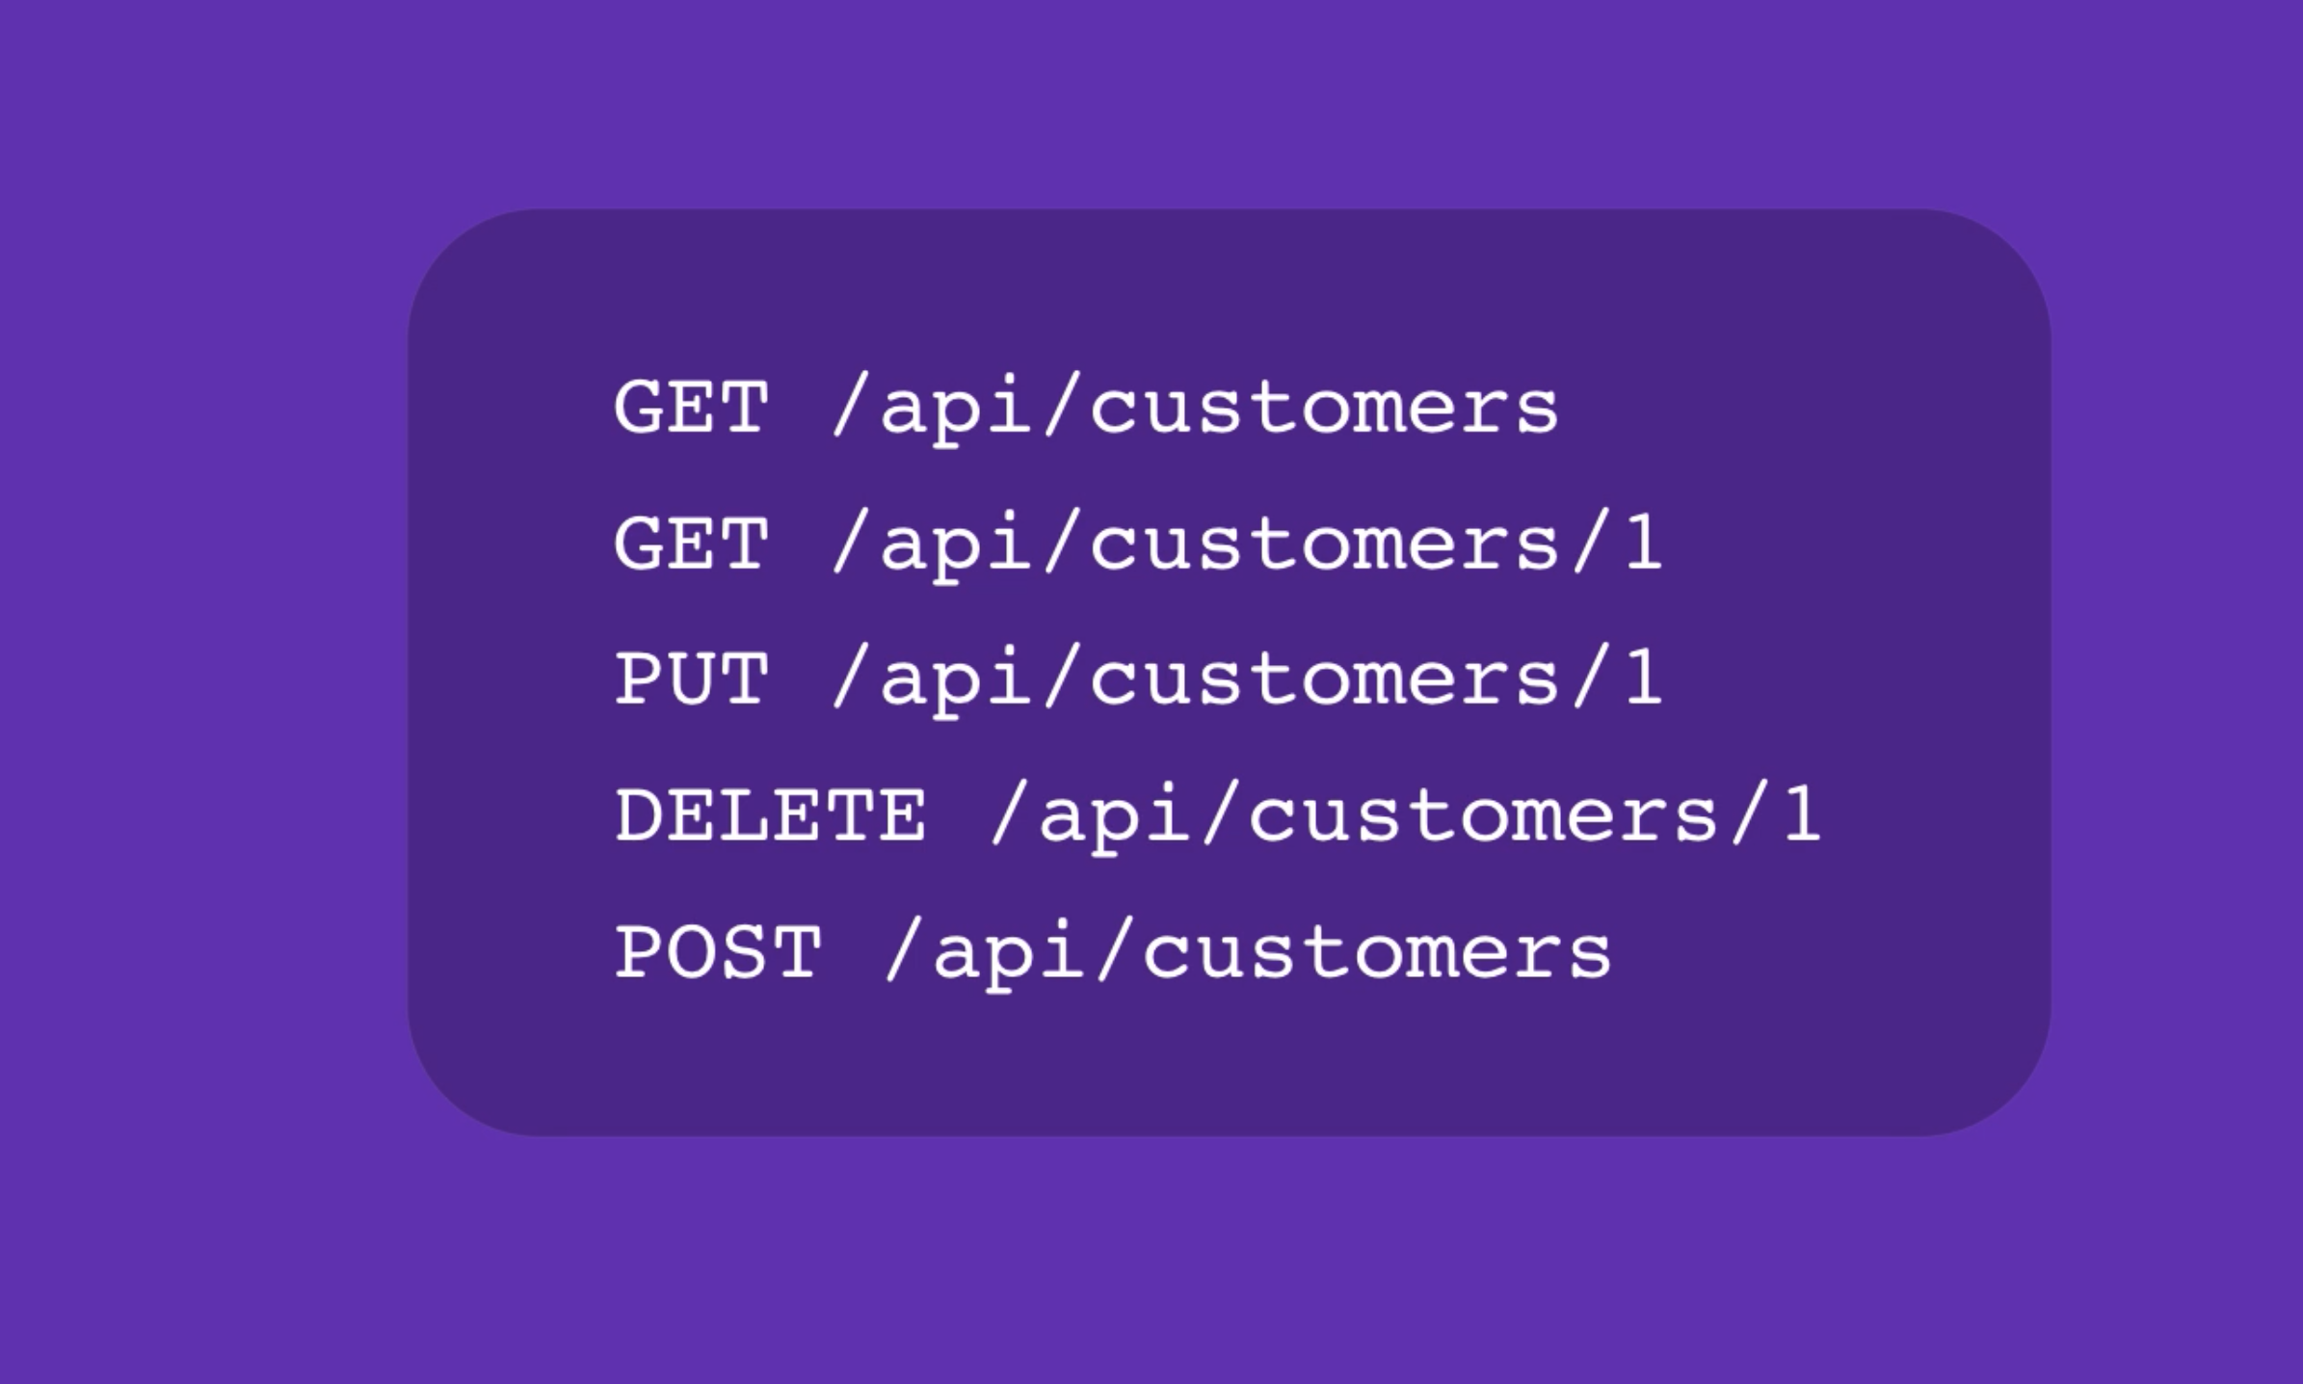
REST API

Slide 16
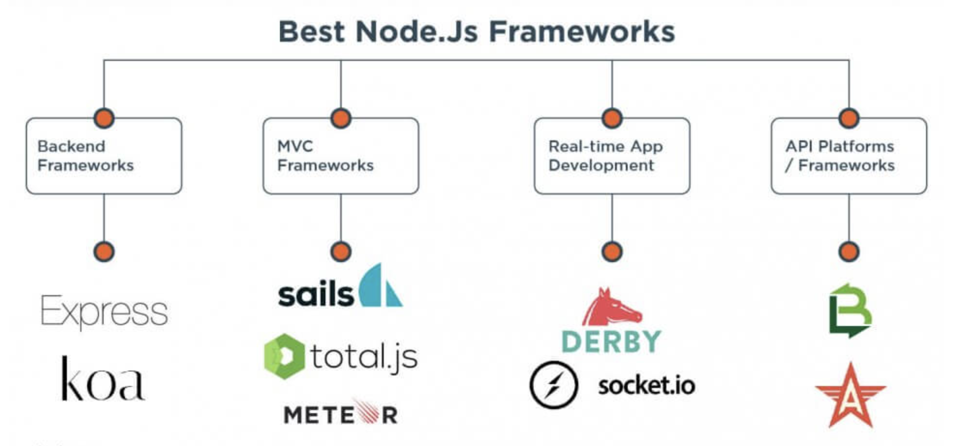
Reference: https://jelvix.com/blog/best-nodejs-frameworks

Slide 17
Express
Express.js is the most popular framework for Node.js. It allows reusing code to process data in web applications, storing user sessions, managing cookie files, and handling the payload. Without a framework, Node.js requires you to rewrite a lot of repetitive processes from scratch.
Advantages
Easy route handling with URLs and HTTP protocol;
Supports middleware, allowing developers to install helpful tools for speed, responds, and performance improvement;
Supports multiple template engines;
Works well with both static and dynamic content;
Easily integrates with SQL and NoSQL databases;
As the most popular Node.js framework has a rich open-source ecosystem.

Slide 18
API and REST
Refer pdf file shared (Product Analyst team)

Slide 19
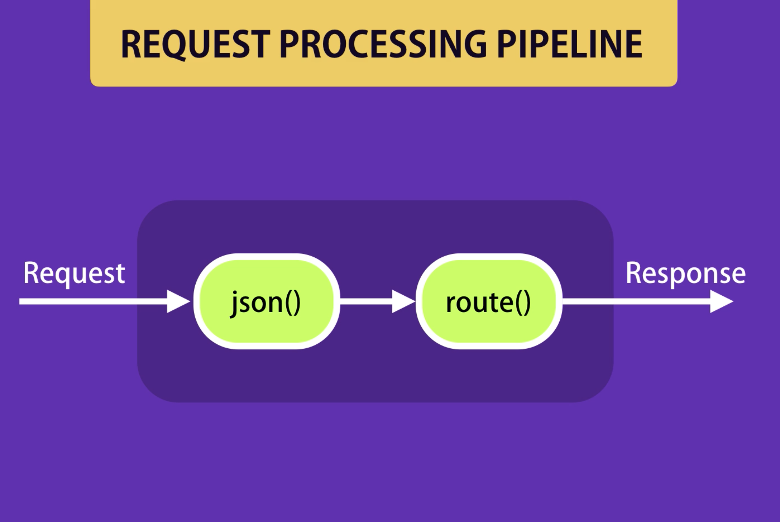
Middleware

Slide 20
Horizontal vs Vertical Scaling

Slide 21


Slide 22
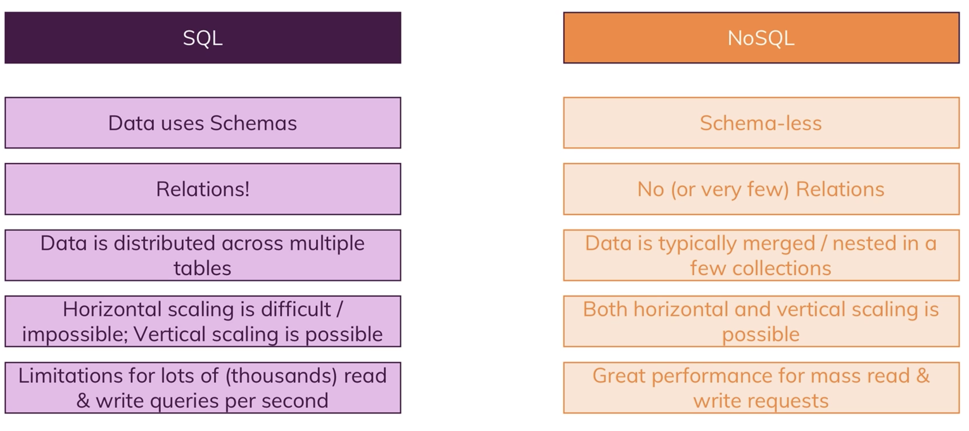
SQL vs NoSQL

Slide 23
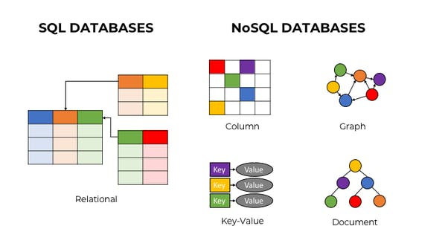
https://www.mongodb.com/nosql-explained
mysql2 – npm install mysql2
Mongodb – npm install mongodb

Slide 24
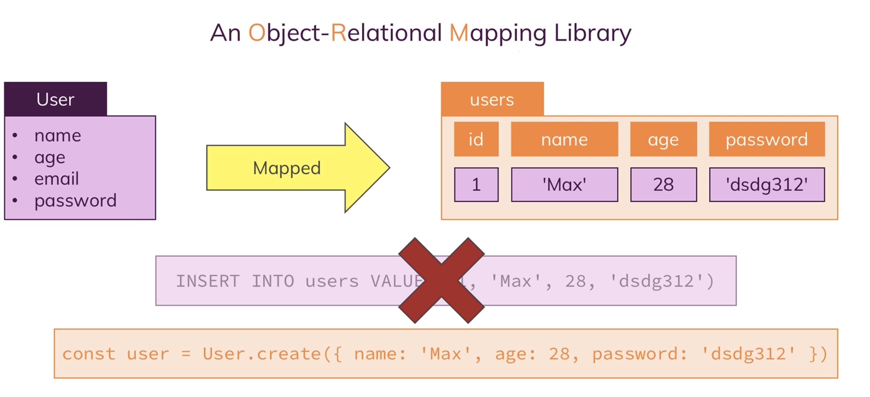
Sequelize
Sequelize is a promise-based Node.js ORM for Postgres, MySQL, MariaDB, SQLite and Microsoft SQL Server.
Npm install sequelize

Slide 25
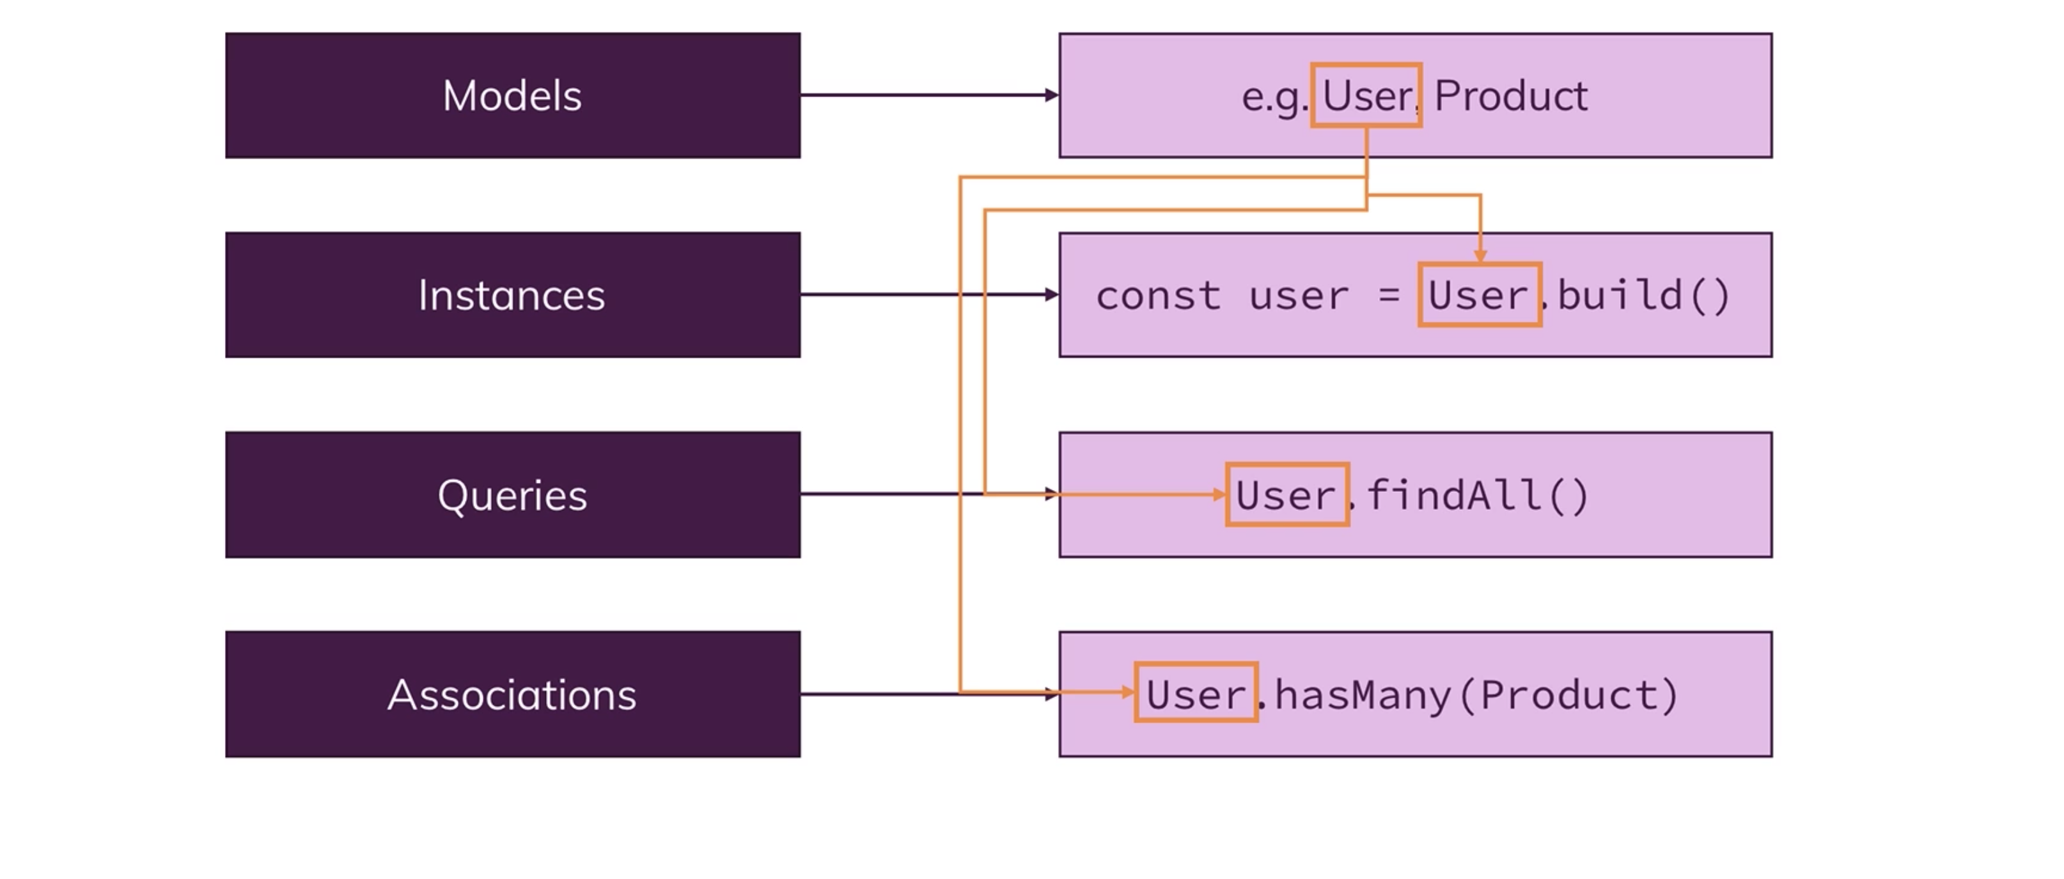
Core concepts of ORM

Slide 26
Mongodb
MongoDB is a document database with the scalability and flexibility that you want with the querying and indexing that you need

Slide 27
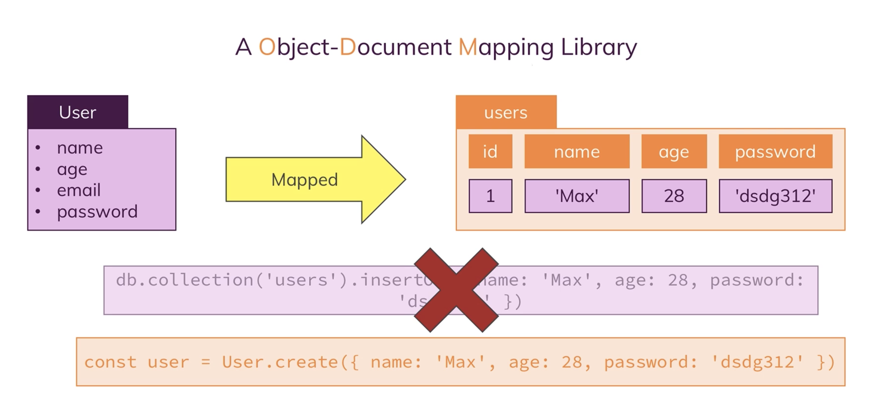
Mongoose

Slide 28
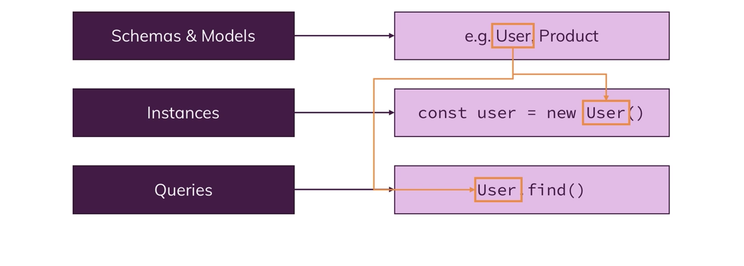
Core concepts of Mongoose

Slide 29
Node.js with Typescript
-> For improving javascript

Slide 30
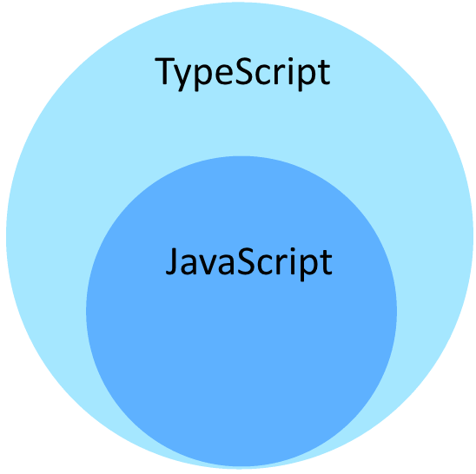
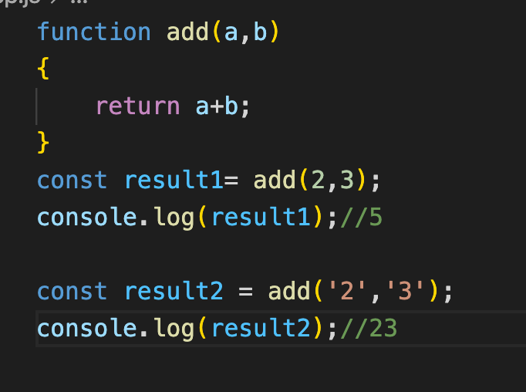
Typescript
Typescript = types + javascript
TypeScript is a strongly typed programming language which builds on JavaScript
Typescript is super set of java script
Compile time check instead of runtime checking on errors. So, we can avoid unwanted behavior at runtime.
Official doc: https://www.typescriptlang.org/

Slide 31
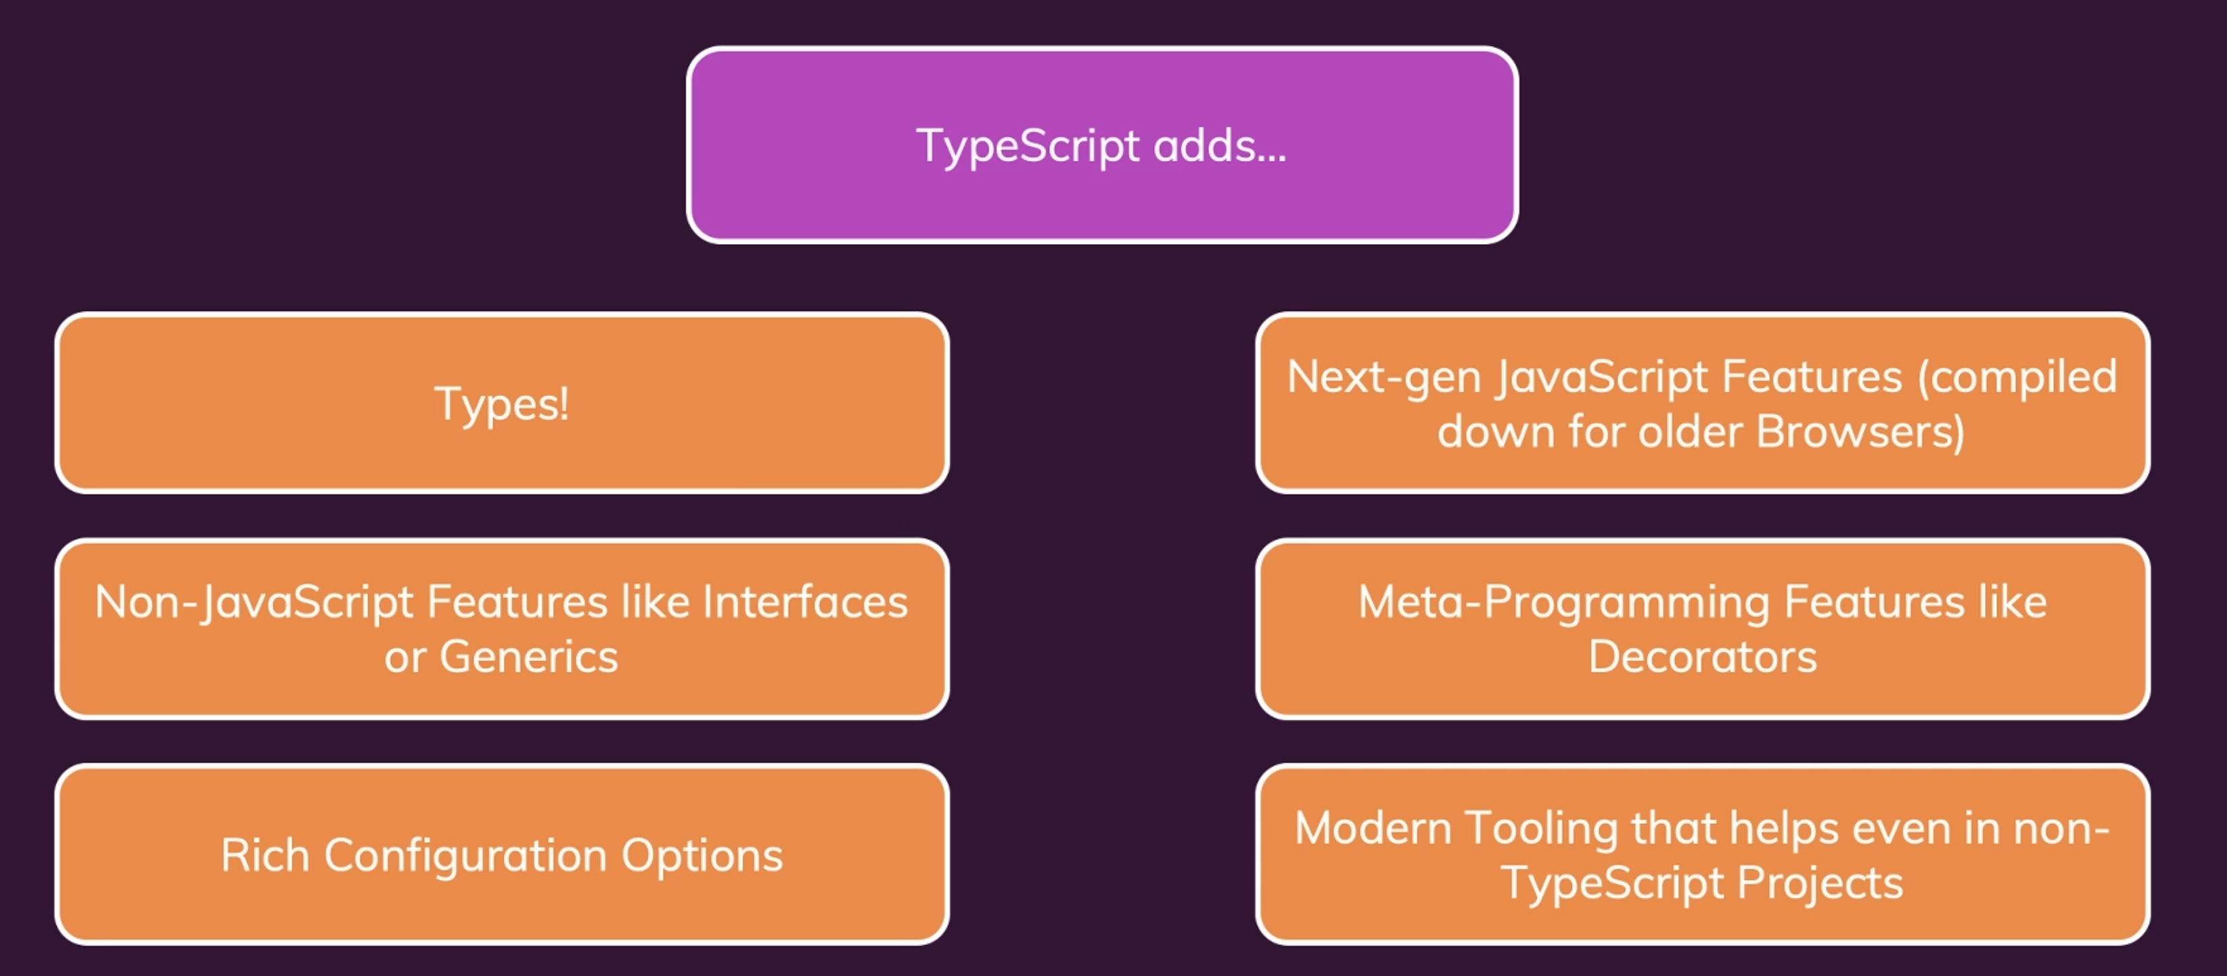

Slide 32
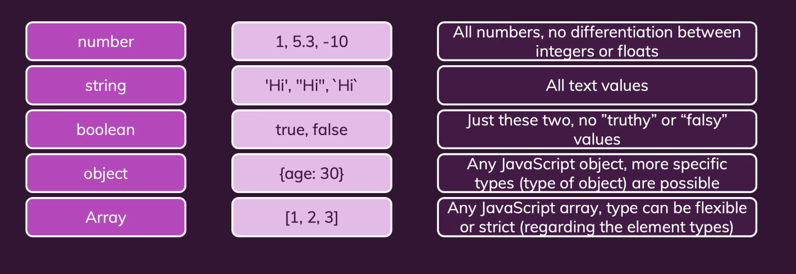
Ts setup and understand types
npm install –g typescript
tsc <typescriptfilename> -> for transpiling .ts to .js
tsc –init for tsconfig.json file

Slide 33
Node + Typescript
npm install -g ts-node
npm install –D typescript ts-node nodemon @types/node @types/express
Enable "moduleResolution": "node” property in tsconfig.json

Slide 34
Unit testing

Slide 35
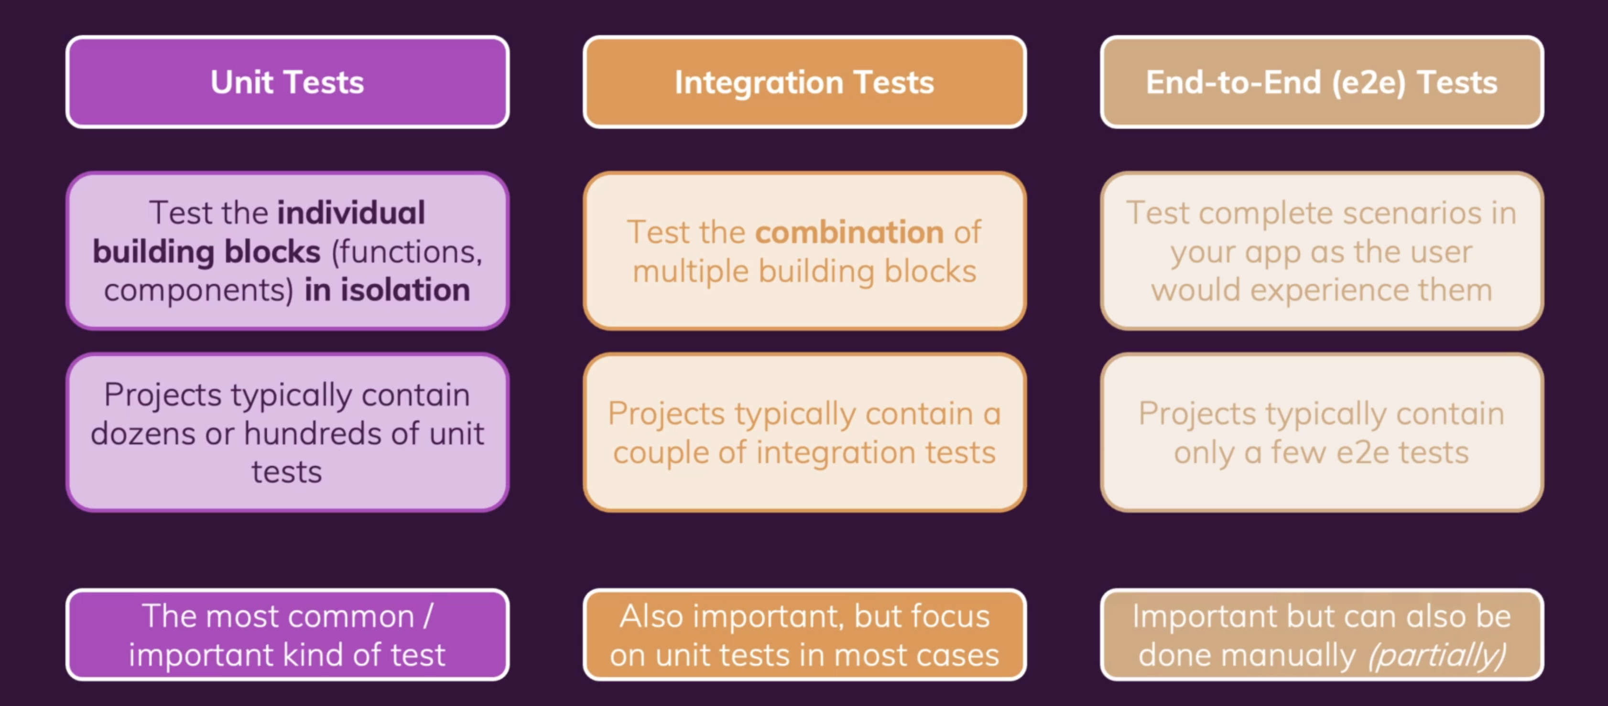
Different types of Automated tests
Types of testing

Slide 36
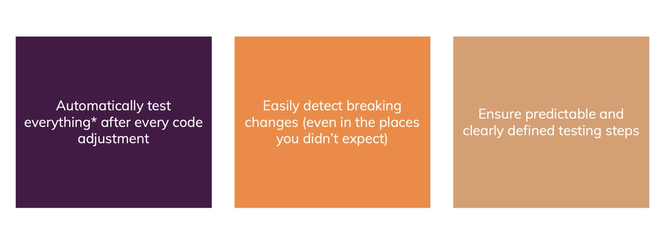
Why testing?

Slide 37
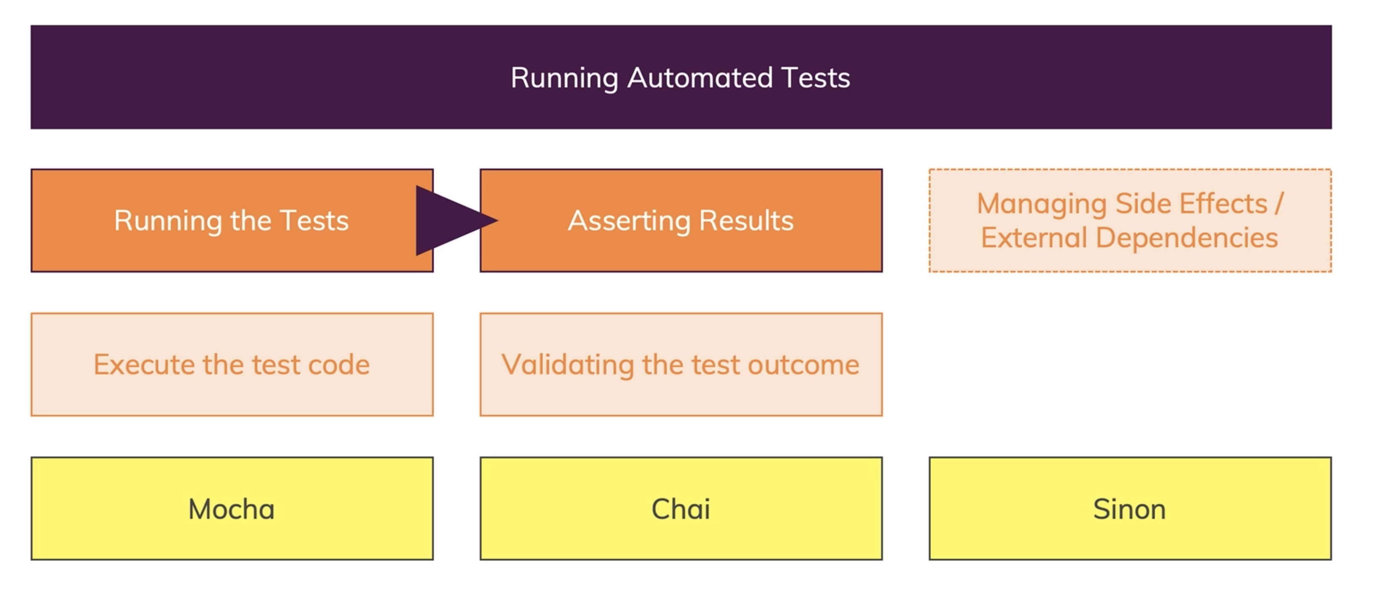
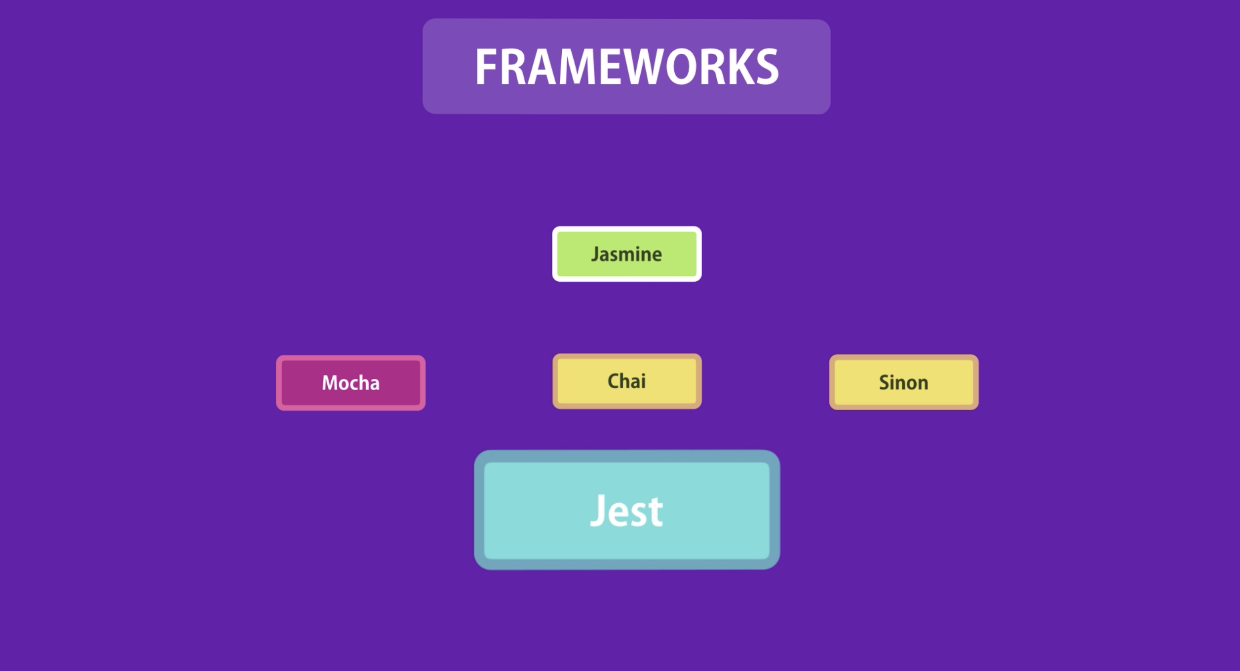
Testing tools and setup
npm i -D typescript jest @types/jest ts-jest
npx ts-jest config:init
ts-jest is a TypeScript preprocessor for jest, that lets you use jest to test projects written in TypeScript.

